Slide 1

Raj Kumar Goel Institute of Technology Ghaziabad
5th KM. STONE, DELHI-MEERUT ROAD, GHAZIABAD (U.P)-201003
Department of Computer Science Engineering & Engineering
Internship Assessment Presentation
for
Internship At InnerCord
by
Chirag Singhal
(2000330100084)

Slide 2
Agenda
Introduction
About InnerCord
MEAN Stack Website I Worked On
Exploring Streamlit in Python
Working with Webflow
Key Learnings From The Internship
Challenges Encountered
Skills Acquired
Future Applications of Learned Skills
Internship's Impact on My Career Prospects
Conclusion & Q/A

Slide 3
Introduction
Worked on Mean Stack website development during the internship
Developed projects using Streamlit in Python
Explored Webflow in Innercord company

Slide 4
About InnerCord
InnerCord
Innercord offers workshops and expert consultation in Ayurveda, Vedic Astrology, Yoga, Mindfulness, and Meditation.
The company's primary objective is to assist individuals in achieving positive transformations in their lives.
InnerCord, where the author completed their internship, is a technology company with expertise in web development.
The main focus of Innercord's services is on technology and web development.
During the internship at InnerCord, the author worked on Mean Stack website development.

Slide 5
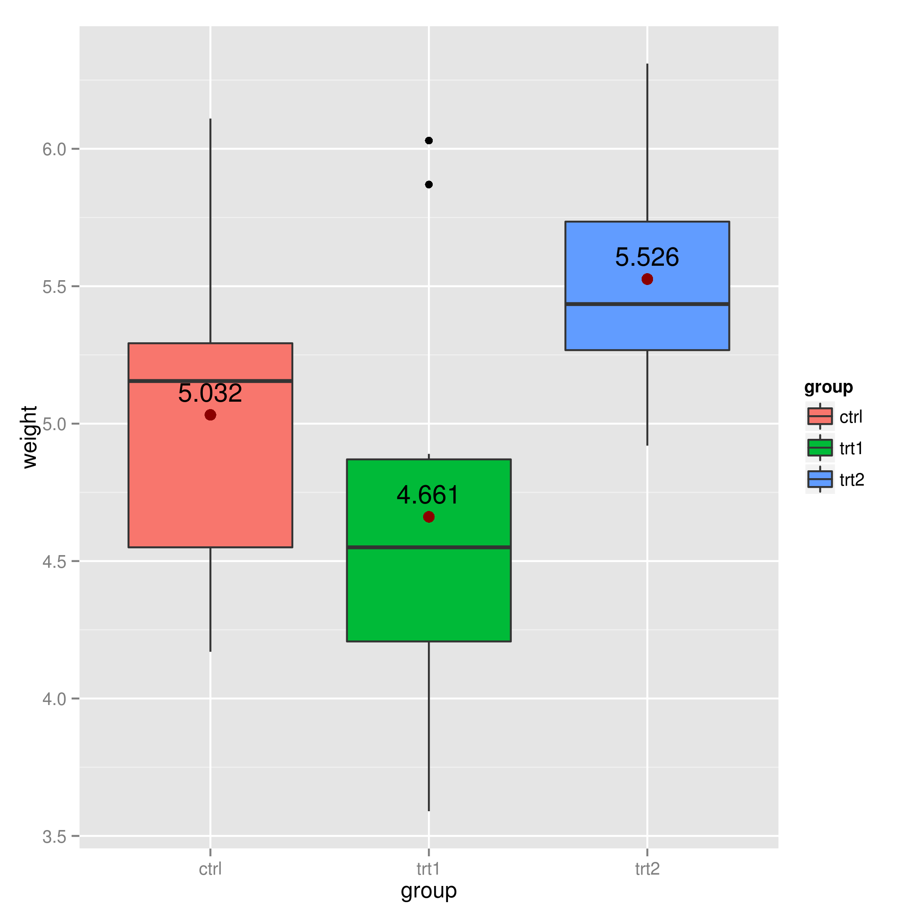
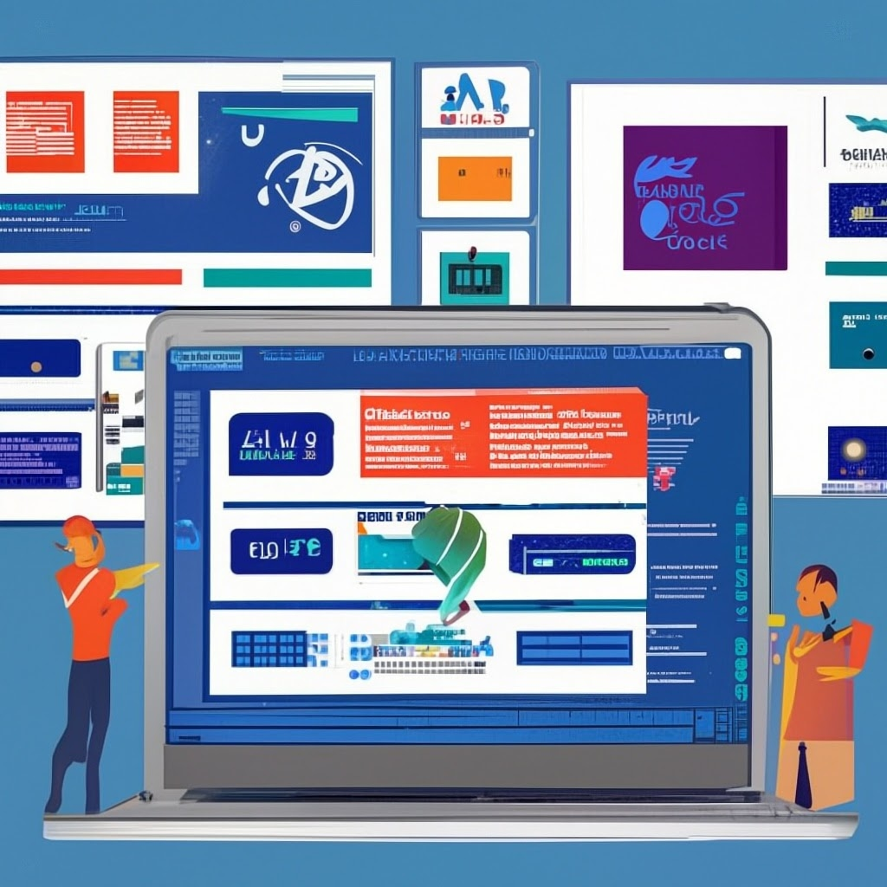
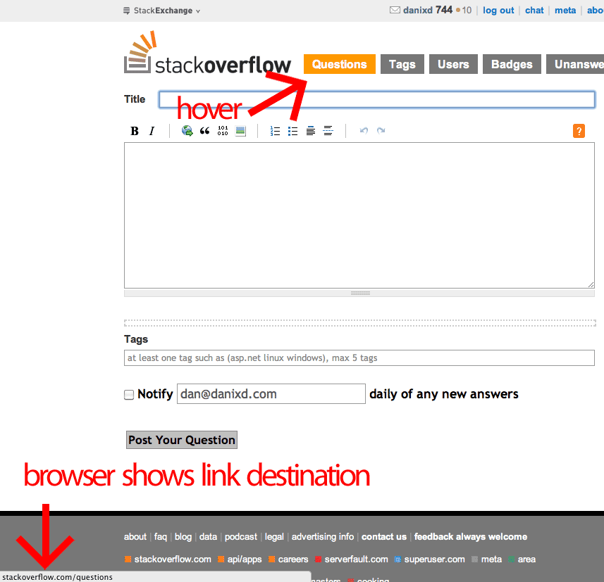

MEAN Stack Website I Worked On
Website Details
I developed a full-stack website using the MEAN stack (MongoDB, Express.js, Angular, Node.js). The website was designed to provide users with a seamless browsing experience and efficient data management.
Key Features
The website incorporated various features such as user authentication, data storage and retrieval from MongoDB, real-time updates using websockets, and responsive design for optimal user experience across devices.

Slide 6

Exploring Streamlit in Python
What is Streamlit?
Streamlit is an open-source Python library that allows you to create interactive web applications with simple Python scripts.
It provides a fast and easy way to build and deploy data science applications without needing expertise in web development.
Streamlit takes care of the front-end components, enabling you to focus on the data analysis and visualization.
Streamlit supports real-time app updates, making it easy to iterate and experiment with your data visualizations.

Slide 7
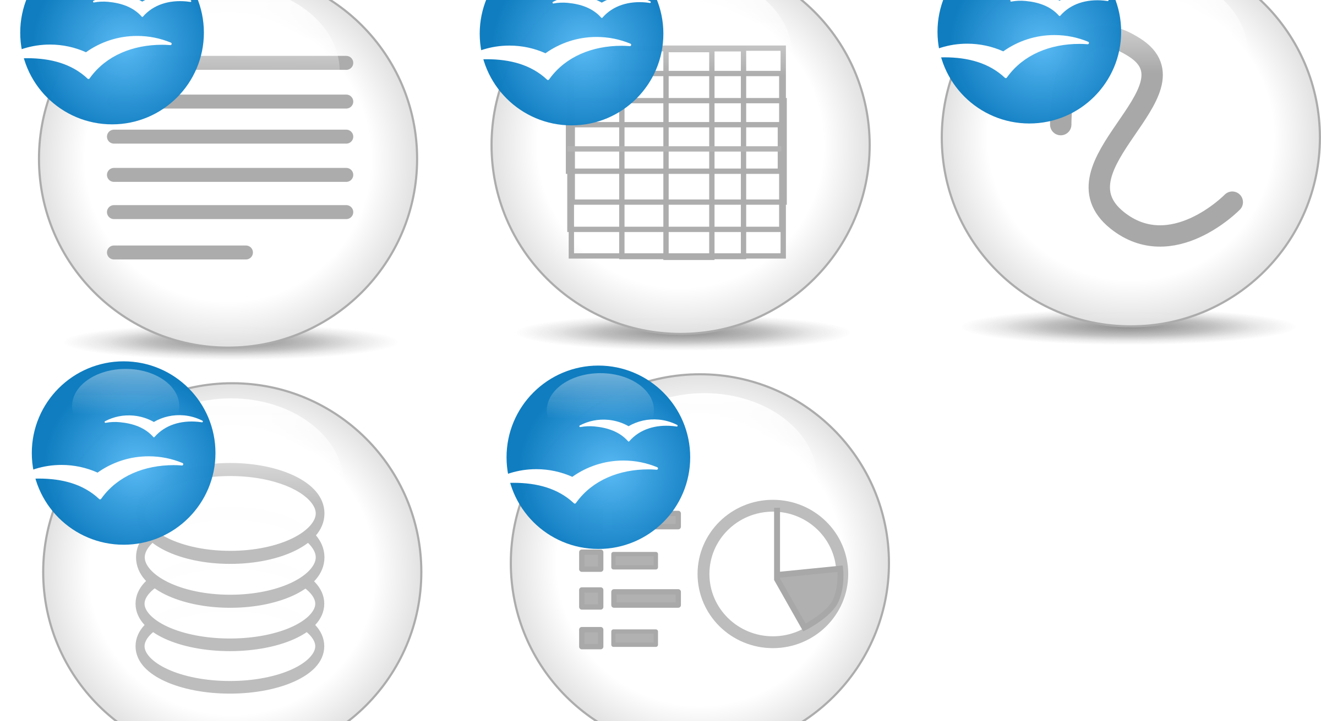
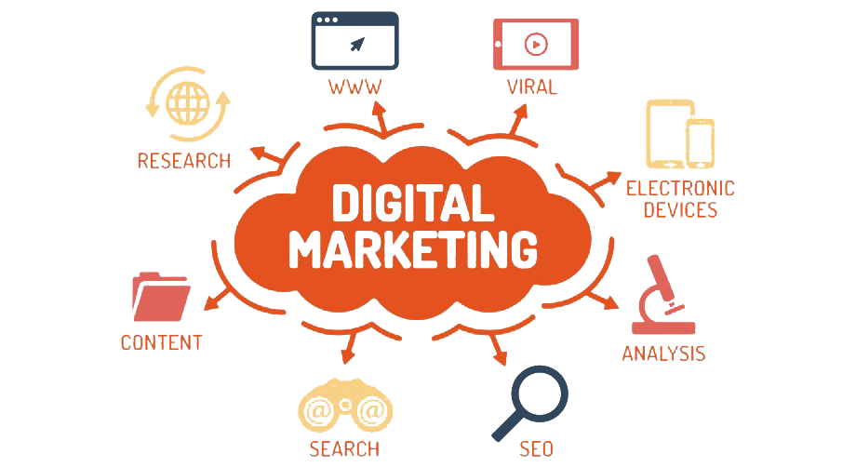
Working with Webflow
What is Webflow?
Webflow Features
Webflow is a visual web development platform that allows users to design, build, and launch responsive websites without coding.
Some key features of Webflow include drag-and-drop functionality, responsive design, CMS integration, and powerful interactions.

Slide 8
Key Learnings From The Internship
MEAN Stack Website
Streamlit in Python
Webflow in Innercord Company
Developed a full-stack website using the MEAN (MongoDB, Express.js, Angular, Node.js) stack.
Explored and worked with Streamlit, a Python library for building data apps.
Gained experience in using Webflow, a visual web development platform, during the internship at Innercord Company.

Slide 9
Challenges Encountered
Learning and implementing the MEAN stack website was challenging due to the complexity of the technology stack.
1
Using Webflow in Innercord company posed challenges in terms of understanding the platform and designing a user-friendly website.
2
Working with streamlit in Python required a deep understanding of data visualization and coding skills.
3

Slide 10
Skills Acquired
MEAN Stack Website
Streamlit in Python
Webflow in Innercord Company
Developed a full-stack website using the MEAN stack (MongoDB, Express.js, Angular, Node.js).
Explored and worked with Streamlit, a Python library for building interactive web applications.
Utilized Webflow, a visual web design tool, to create and design websites during the internship at Innercord Company.

Slide 11
Future Applications of Learned Skills
1
2
3
The MEAN stack website development skills can be applied to build dynamic and interactive web applications.
The knowledge of Webflow can be leveraged to design and develop visually appealing and responsive websites.
Streamlit in Python can be utilized to create data-driven and interactive web applications for data analysis and visualization.

Slide 12

Internship's Impact on My Career Prospects
Key Learnings from Internship:
Developed proficiency in MEAN Stack development
Gained experience in using Streamlit in Python for data visualization
Learned Webflow to design and develop websites
Improved problem-solving and critical thinking skills

Slide 13
Conclusion & Q/A
Conclusion
Q/A
In conclusion, my internship experience at Innercord Company was highly valuable and impactful.
I had the opportunity to work on various technologies including the MEAN stack, Streamlit in Python, and Webflow.
I gained hands-on experience in developing MEAN stack websites, creating interactive data apps using Streamlit, and designing websites with Webflow.
I am grateful for the knowledge and skills I have acquired during my internship, and I believe it has prepared me well for my future career in web development.
I am now open to answering any questions you may have about my internship experience, the technologies I worked with, or any other related topics.
Please feel free to ask your questions.

